Slide 1


Amazon Fresh Database Analytics
This presentation explores the Amazon Fresh database, focusing on relationships between tables, key constraints, and actionable insights derived from SQL queries.
by Mohammed Niyaz.M

Slide 2
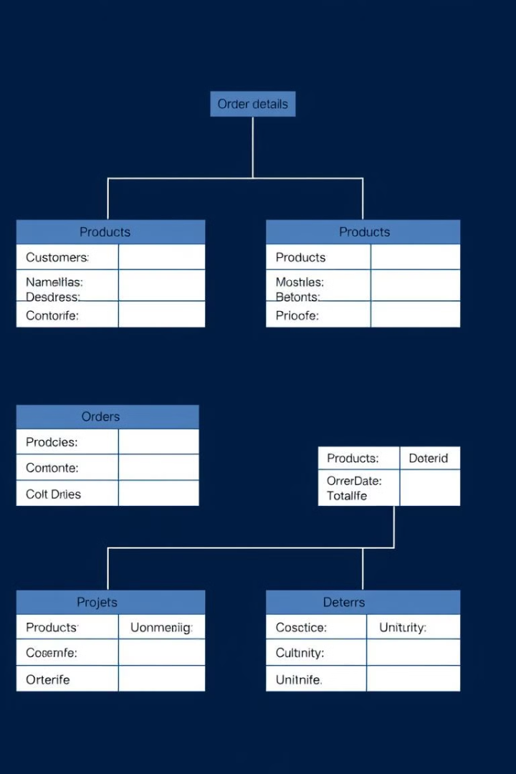
ER Diagram and Key Constraints
The Amazon Fresh database includes tables like Customers, Products, and Orders. Understanding their relationships is crucial for effective data analysis. Primary keys uniquely identify records, while foreign keys establish links between tables, ensuring data integrity.
For example, CustomerID in the Customers table is a primary key, and it appears as a foreign key in the Orders table, linking customers to their orders.
Primary Keys
Foreign Keys
Uniquely identify records within a table.
Establish links between tables, ensuring referential integrity.
Relationships
Define how tables are related (e.g., one-to-many, many-to-many).

Slide 3
Basic Data Retrieval
SQL queries enable us to retrieve specific data from the database. For instance, we can fetch all customers from a specific city or list all products under the "Fruits" category. These queries use the SELECT statement with a WHERE clause to filter the results.
Example: SELECT * FROM customers WHERE city = 'West Paula';
Customers from West Paula
Products in "Fruits" Category
SELECT * FROM customers WHERE city = 'West Paula';
SELECT * FROM products WHERE category = 'fruits';

Slide 4

DDL Statements and Constraints
Data Definition Language (DDL) statements are used to define the database schema. Constraints enforce rules on the data. For example, we can ensure that the Age column in the Customers table cannot be null and must be greater than 18.
We can also add a unique constraint for the Name column to prevent duplicate names.
Primary Key
Age Constraint
Unique Constraint
CustomerID as the primary key.
Age cannot be null and must be greater than 18.
Add a unique constraint for Name.

Slide 5
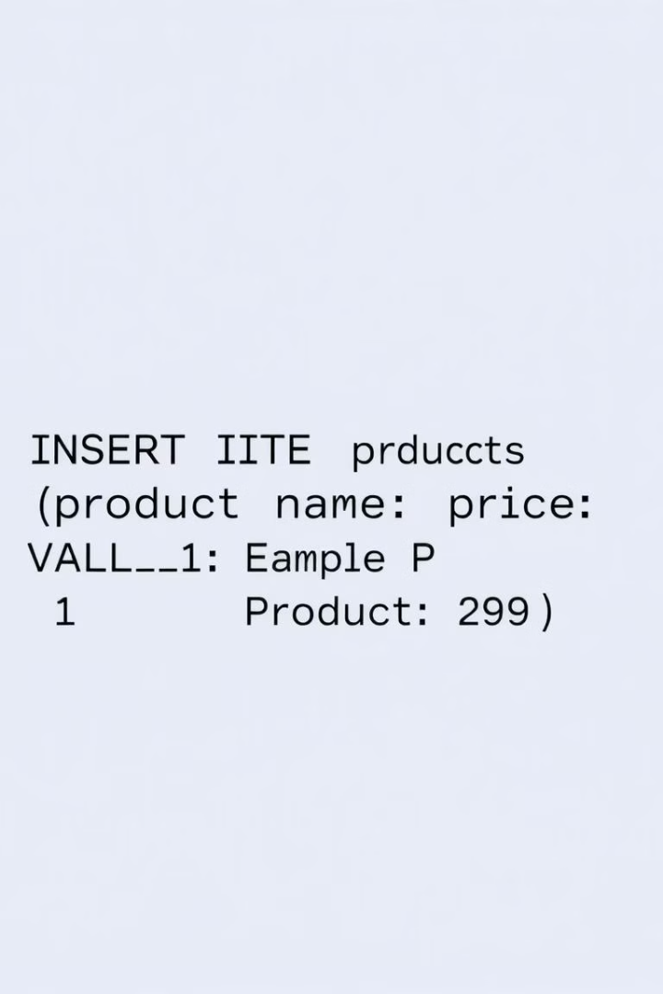



Inserting New Data
The INSERT statement is used to add new rows to a table. For example, we can insert three new rows into the Products table with specific values for product ID, name, category, price, stock quantity, and supplier ID.
Example: INSERT INTO Products (productid, productname, category, subcategory, priceperunit, stockquantity, supplierid) VALUES (1, 'Organic Apples', 'Fruits', 'Sub-Fruits-1', 3.99, 100, 1), (2, 'Almond Milk', 'Dairy Alternatives', 'Sub-Dairy-1', 2.49, 200, 2), (3, 'Whole Wheat Bread', 'Bakery', 'Sub-Snacks-1', 1.99, 150, 3);
Add Rows
Products Table
Database

Slide 6



Updating and Deleting Data
The UPDATE statement modifies existing data, while the DELETE statement removes data. For example, we can update the stock quantity of a product or delete a supplier from the Suppliers table based on certain conditions.
Example: UPDATE Products SET StockQuantity = 120 WHERE ProductID = 1;
Update
Modify existing data.
Delete
Remove data.

Slide 7


SQL Constraints: CHECK and DEFAULT
SQL constraints ensure data integrity. A CHECK constraint limits the values that can be stored in a column. A DEFAULT constraint provides a default value for a column when no value is specified during insertion.
Example: ALTER TABLE Reviews ADD CONSTRAINT CHECK (Rating BETWEEN 1 AND 5);
CHECK
1
DEFAULT
Limits values in a column.
2
Provides a default value.

Slide 8
Advanced Queries: WHERE, HAVING, GROUP BY, ORDER BY
These clauses allow for more complex data retrieval. WHERE filters rows, HAVING filters groups, GROUP BY groups rows with the same values, and ORDER BY sorts the results.
Example: SELECT P.ProductID, P.ProductName, SUM(OD.Quantity * P.PricePerUnit) AS TotalSales, AVG(R.Rating) AS AvgRating FROM Orders AS O JOIN Order_Details AS OD ON O.OrderID = OD.OrderID JOIN Products AS P ON OD.ProductID = P.ProductID LEFT JOIN Reviews AS R ON P.ProductID = R.ProductID WHERE O.OrderDate > '2024-01-01' GROUP BY P.ProductID, P.ProductName HAVING AVG(R.Rating) > 4 ORDER BY TotalSales DESC;
1
WHERE
2
GROUP BY
3
ORDER BY

Slide 9

Joins and Subqueries
Joins combine rows from two or more tables based on a related column. Subqueries are queries nested inside another query. They are used to retrieve data that will be used in the main query.
Example: SELECT Orders.OrderID, Orders.CustomerID, SUM(order_details.Quantity * order_details.UnitPrice * (1 - order_details.Discount / 100)) AS TotalRevenue FROM Orders JOIN order_details ON Orders.OrderID = order_details.OrderID GROUP BY Orders.OrderID, Orders.CustomerID;
2
Tables
Combine data from multiple tables.
1
Subquery
Nest queries for complex logic.

Slide 10



Actionable Insights
SQL queries can provide valuable insights. For example, we can identify cities with the highest concentration of Prime members or determine the top 3 most frequently ordered categories.
Example: SELECT City, COUNT(CustomerID) AS PrimeMemberCount FROM customers WHERE primemember = 'yes' AND city IS NOT NULL GROUP BY city ORDER BY PrimeMemberCount DESC;
Insights
1
Drive informed decisions.
Queries
2
Extract relevant data.
Database
3
Analyze Amazon Fresh data.

